Slide 1
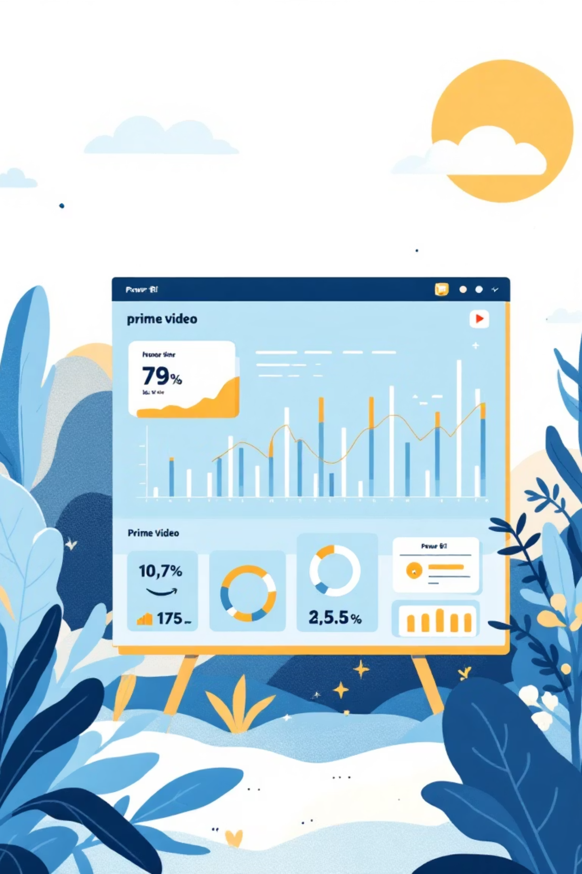
AMAZON PRIME VIDEO
DASHBOARD USING POWER BI
DATA PROCESSING AND BUSINESS ANALYSIS PROJECT
Presented by: Nisarga N and Brunda N

Slide 2


PROJECT OBJECTIVE & DATASET OVERVIEW
OBJECTIVE
DATASET DESCRIPTION
Our primary goal is to leverage Power BI to analyze Amazon Prime Video data, uncovering key trends in its vast catalog of shows and movies. We aim to visualize distributions across countries, types, and ratings, providing actionable insights into content strategy.
Source: Kaggle – Amazon Prime Video Movies & TV Shows Dataset
Key Columns: Title, Type, Director, Country, Release Year, Rating, Duration and
Genre

Slide 3


PURPOSE OF THE PROJECT
To see how many movies and TV shows are there in total.
To find out which type (like Drama, Comedy, etc.) are most popular.
To check which countries have more Prime Video content.
To compare the number of movies and TV shows.
To know how Prime Video’s collection has grown from over the years.
WHAT WE LEARN
This project helps us see what type of content people prefer, which countries are most active, and how Prime Video has expanded over time. It turns simple data into a clear and colorful dashboard using Power BI.

Slide 4

THE COMPLETED POWER BI DASHBOARD
Our comprehensive Power BI dashboard brings together all the visualizations and key metrics into one interactive interface.
9655
25
519
Total Titles
Total Ratings
Total Genres
A vast library of movies & TV shows
Diverse content for all audiences
Rich variety in content categories
5771
Total Directors
A multitude of creative voices

Slide 5

CONCLUSION:
Power BI proves to be an indispensable tool for transforming raw streaming data into clear, actionable business intelligence. Our dashboard provides a robust framework for understanding content trends and informing strategic decisions in the competitive streaming market.
Thank You!

Slide 6

REFERENCES
Our project's foundation is built upon reliable data and expert guidance.
References
Dataset: Kaggle – Amazon Prime Video Dataset
Tool: Microsoft Power BI

Slide 7
THANK YOU

